Slide 1
MANUU MARKET-PLACE
Under the guidance of
Dr Fareeha Rasheed
Assistant Professor
Md Yazdan Rizwan
19BTCS008HY
Ataliya Aarfeen 19BTCS023HY

Slide 2
Table of contents
Introduction
Objective
Problem Statement
Functional Requirement
DFD
Tools and platform used
Summary
Bibliography

Slide 3
Introduction
Marketplace provides a platform where registered users can buy and sell products or items online.
A MANUU marketplace exclusively for universities would be a platform where university students, faculty, and staff can buy and sell goods and services within the university community.

Slide 4
Objectives
Provide a user-friendly platform exclusive for university members to buy/sell goods within the university!
Provide a trusted and reliable source for university members to buy/sell goods within their campus.

Slide 5
Problem Statement
University students and staff often face challenges in buying and selling goods and services within their campus. While there are existing online marketplaces that cater to general audiences, there is a lack of dedicated platforms that specifically address the unique needs and preferences of universities.
As a result, there is a need for an online marketplace exclusively for universities that can provide a secure, convenient, and cost-effective way for members of the university to buy and sell goods and services within their campus network.
The platform should address issues such as user authentication, trust and transparency, and easy communication between buyers and sellers.

Slide 6
Functional Requirement
The system offers the following features;
• User registration
• Delete/Update Products
• Admin has the rights to delete the product
• Listed Item
• Contact Us

Slide 7
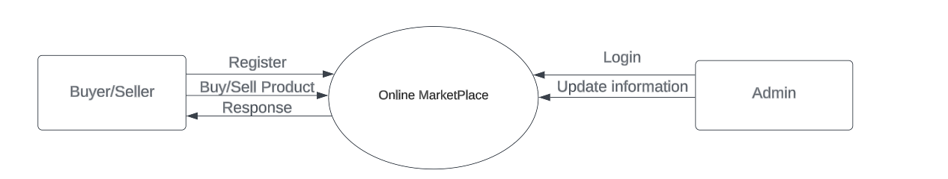
0 level DFD’S

Slide 8
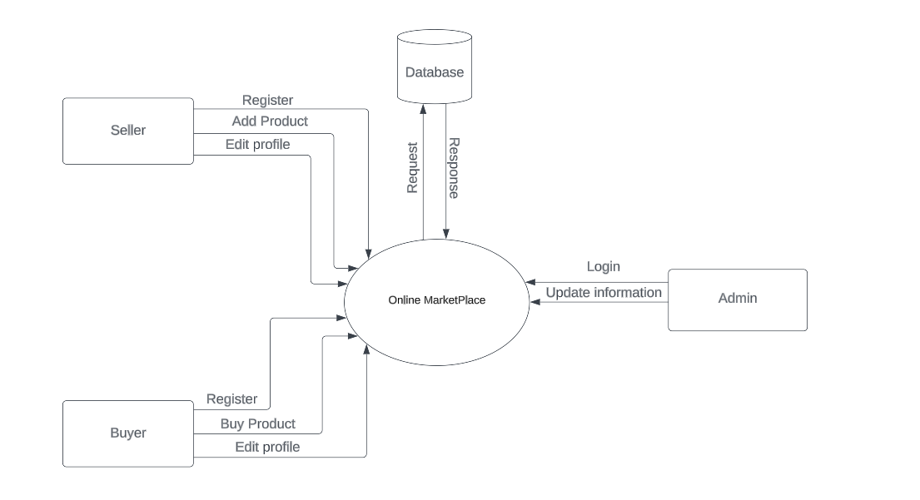
1 level DFD’S

Slide 9
Tools & Platform Used
The Platform used: Visual Studio Code.
Technology: Fronted- End: HTML, CSS, JavaScript, ReactJs
Back-End: Java, Servlets, JSP
Database: MySql

Slide 10
Summary
Finally we conclude that this web application provides a dynamic, well-service oriented, user-friendly, flexible to use, and time-saving system where the selling and buying of products can be easily carried out by clients in a shorter time.
Buyers can easily search for items and they can even request the item they want to buy if the desired item is not there.
This module is very useful to Buyers and sellers. Admin can gain profit by using this site. Our future work will involve a more in-depth analysis of the website for user behavior.

Slide 11
Bibliography
www.olx.in
www.quikr.com

Slide 12
Thank you

